Slide 1
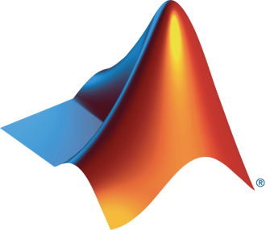

University of and MathWorks Present: Image Processing Onramp

Slide 2
Today:
6:15 pm – 6.30 pm: Set-up
Intro to Image Processing
Create MathWorks account
Log in to Image Processing Onramp / Test MATLAB Online
6.30 pm – 8.00 pm: Image Processing Onramp (on your own)

Slide 3
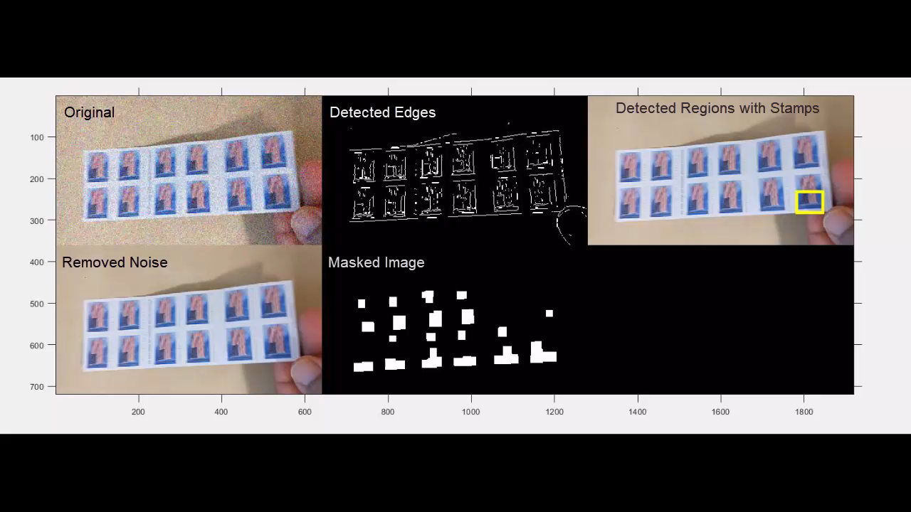
What is Image Processing?
Detecting Stamps
Performing certain operations on an image to get an enhanced image or extract some useful information from it
Example processes
Noise removal​
Deblurring​
Filtering
Notes:
So what is image processing?
Image process or digital image processing involves performing certain operations on an image, in order to get an enhanced image or to extract some useful information from it. Like in this simple example, image processing has been used to sharpen the images, then to detect the individual stamps based on some extracted information and then to count the stamps.

Slide 4
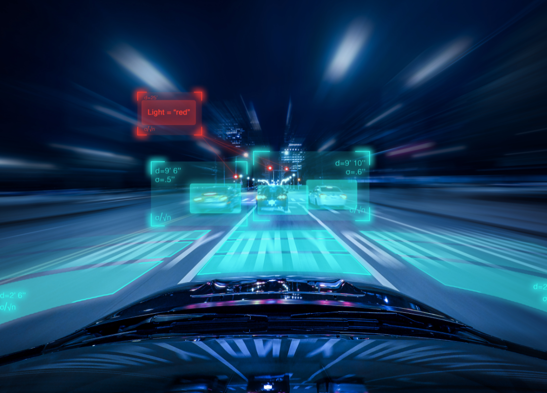
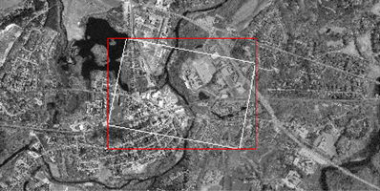

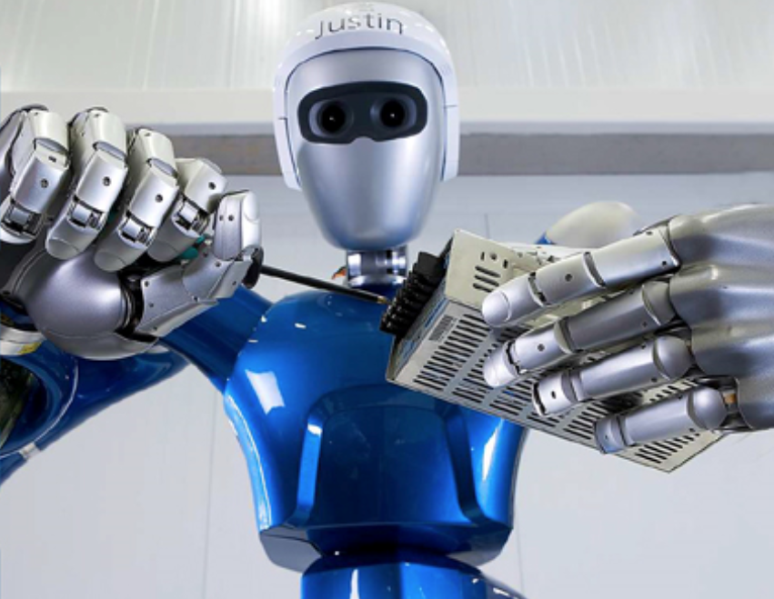
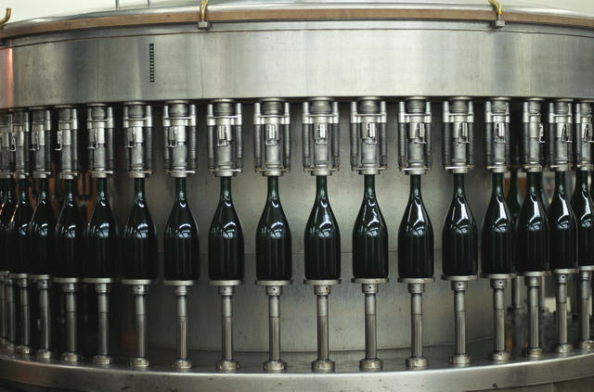
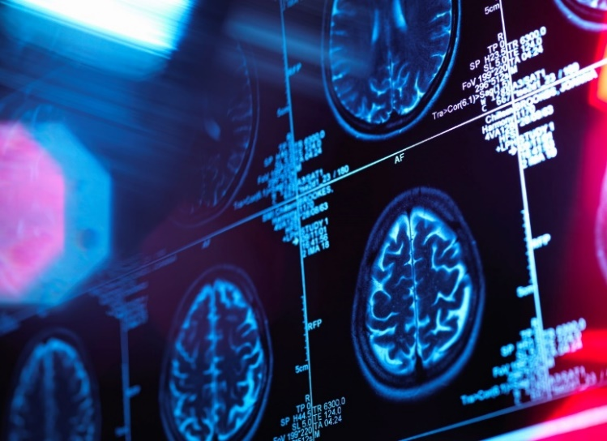
Image Processing Applications
Automated Driving
Satellite Imagery
Consumer Electronics
Robotics
Machine Vision
Medical Imaging
Notes:
Automated Driving
Satellite Imagery
Medical imaging
Consumer electronics
Machine vision
Surveillance
Robotics
and more…

Slide 5
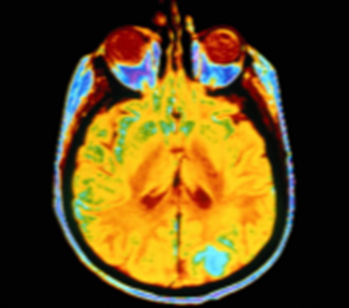
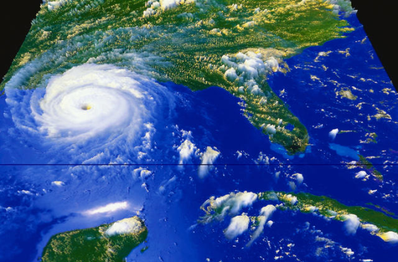
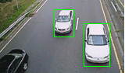
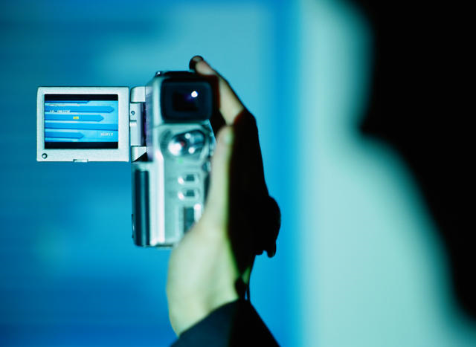
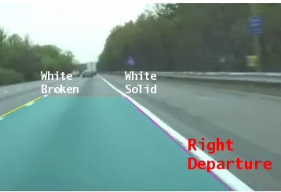
Applications: Image and Video Processing
Medical imaging
Surveillance
Robotics
Automotive safety
Consumer electronics
Geospatial computing
Machine vision
and more…
Notes:
Images and video are used in a wide range of applications, from robots and cars to environmental science and medicine. Our recent release has many new capabilities that expand what customers can do with our tools. In particular, automatic image registration is a workflow that is important to every application on this slide and we can now claim to have a great solution. Let’s now take a look at image registration as well as the other new capabilities available in our latest release.
General image processing workflow involves ,
Capture images
Apply algorithms
Calculate errors
Compare results
Images are captured on a variety of devices at different cost levels from space telescopes and medical imaging to webcams and in-expensive digital cameras. One specific example of image processing is to align data acquired from various sources and using it for …. Whether you’re using a digital camera or a sophesticated imaging device, you might want to capture images at different aperture levels and evaluate alternate solutions to solve the problem. Developing a non-standard solution requires an open and flexible environment to enable data exploration, algorithm development and application deployment.

Slide 6
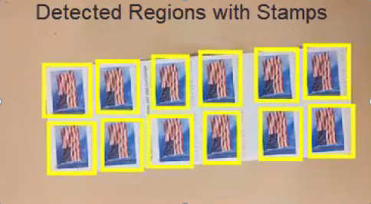
Typical Challenges
How do I get started?
How do I learn about different techniques?
Detecting Stamps
How do I explore options to solve my problem?
How do I test my ideas on large datasets?

Slide 7
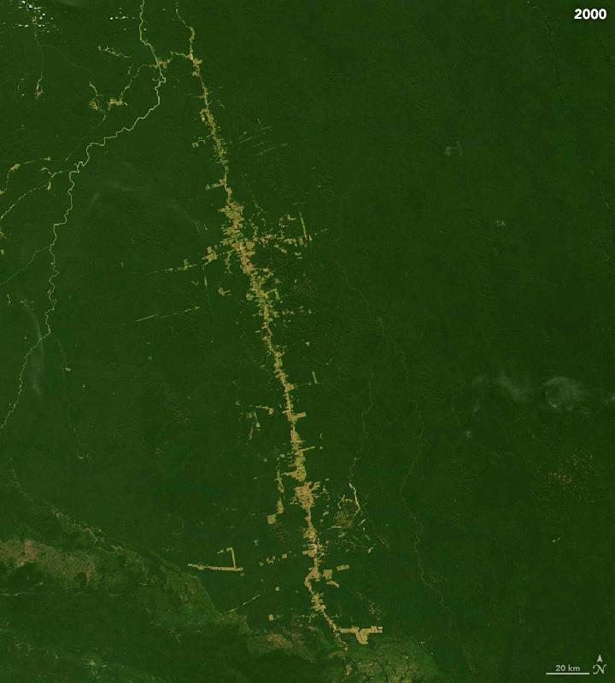
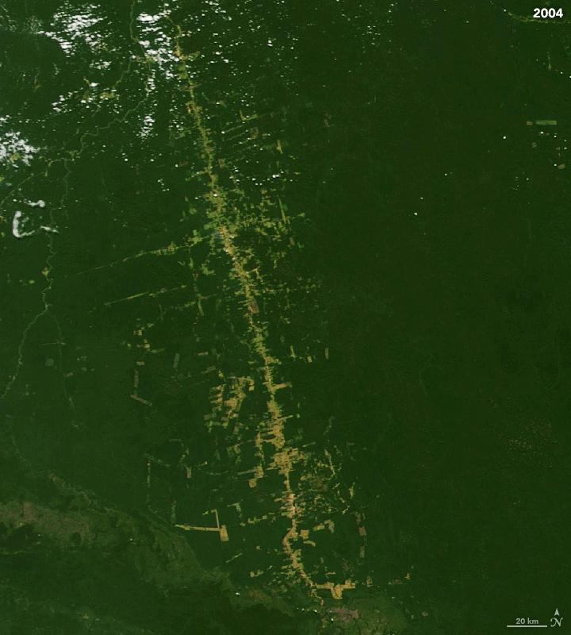
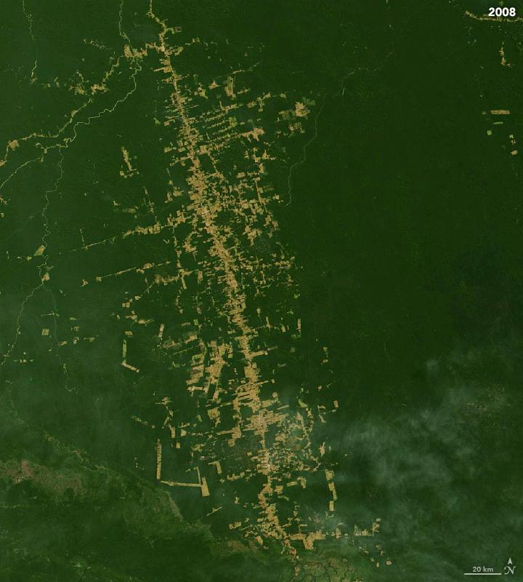
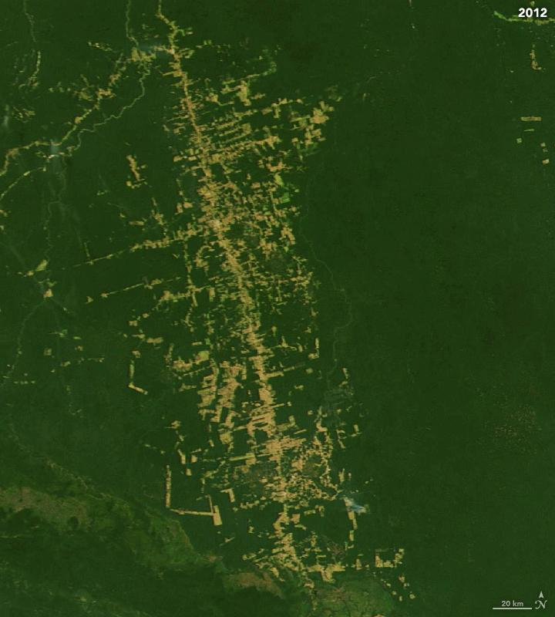
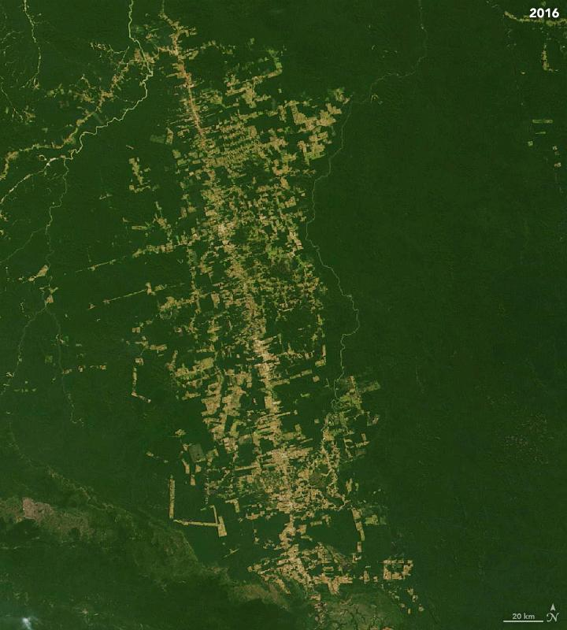
Amazon Rainforest Deforestation Demo
How did deforestation in the Amazon rainforest change from 2000 to 2016?
2000
2004
2008
2012
2016
Notes:
The first demo we see today is the Amazon rainforest deforestation demo. In this demo, we would like to explore how the deforested area has changes from 2000 to 2016 in a small part of the rainforest and quantify it. We use 5 images taken 4 years apart to do this.
So, lets jump into MATLAB explore the demo.
💻 Run “amazonRainforestSegmentation.prj project” in MATLAB and open “Amazon Rainforest Segmentation Demo” in the project shortcuts 👆

Slide 8
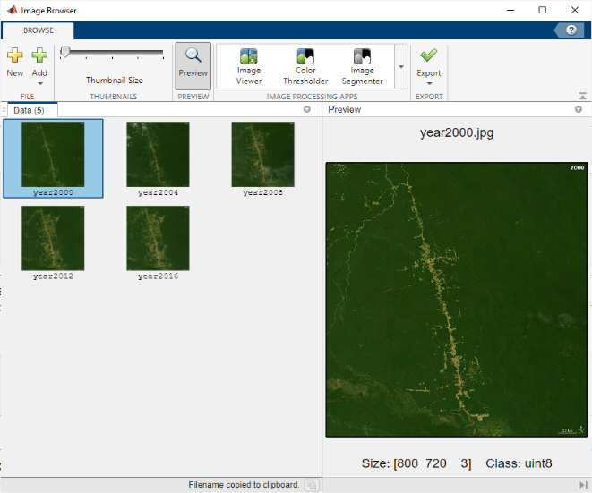
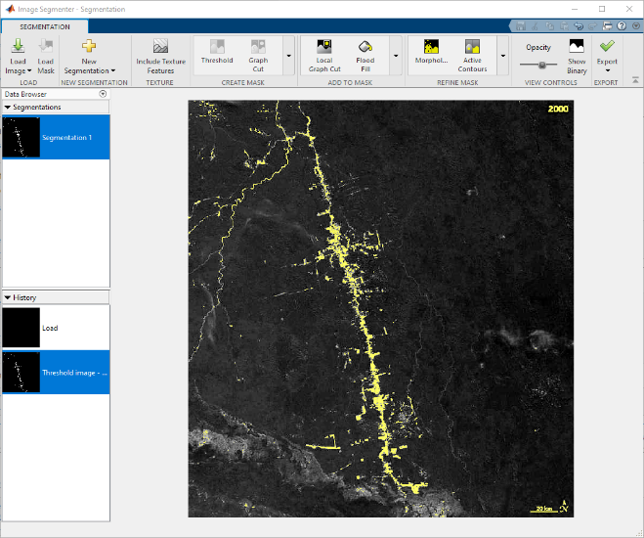
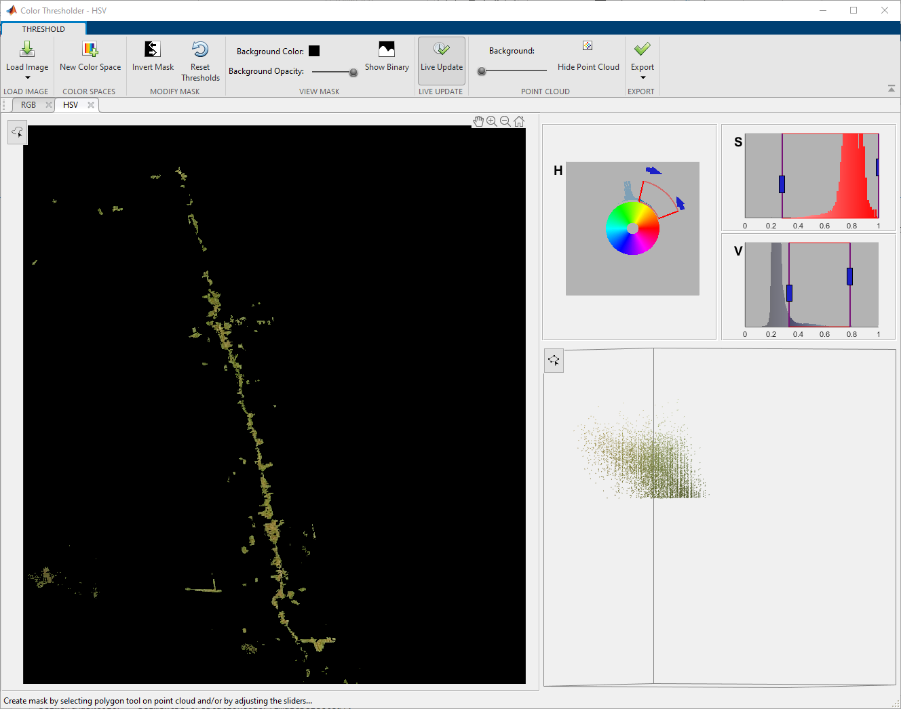
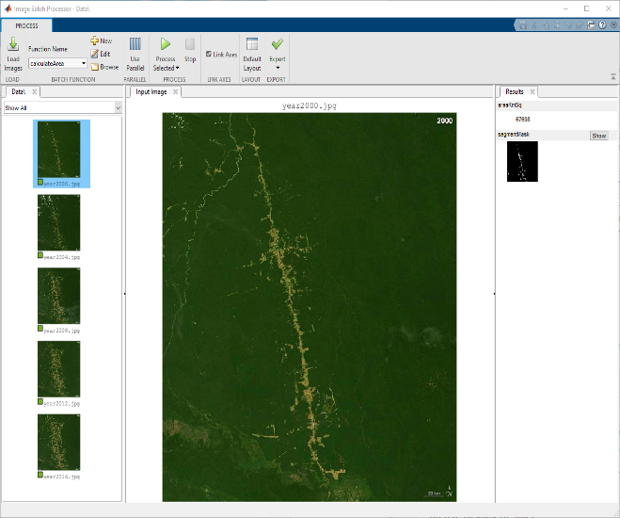
Amazon Rainforest Deforestation Demo Takeaways
Image Browser App
Image Segmenter App
Color Thresholder App
Image Batch Processor App
Notes:
💻 Return from MATLAB
So now that we have explored the demo, the approach we took started by reviewing the images, trying 2 different segmentation approaches and finally combining the approach into a function and applying it to multiple images using batch processing. 👆

Slide 9
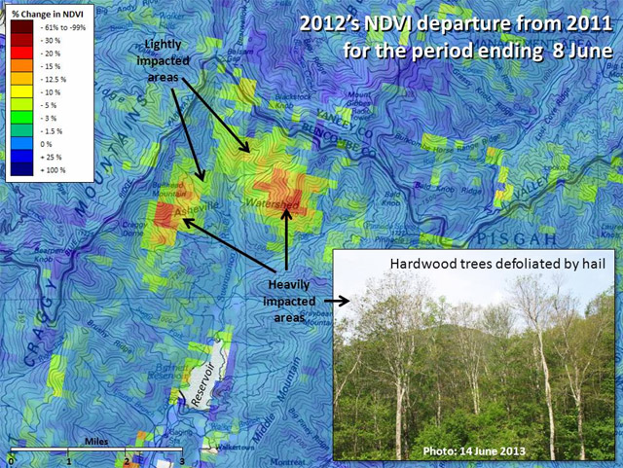
NASA Develops Early Warning System for Detecting Forest Disturbances
“Soon after ForWarn moved into production, it detected previously unnoticed hail damage that posed a threat to a watershed. We would not have been able to do this work as efficiently without MATLAB.”
– Duane Armstrong, NASA Stennis Space Center
U.S. Forest Change Assessment Viewer map showing damage to the Asheville, North Carolina watershed following a 2012 hailstorm. Image courtesy ForWarn.
Notes:
Here we highlight how our IP and CV capabilities are used by NASA for detecting forest disturbances such as droughts, wildfires, insects, hail damage and others. Using our tools, they were able to implement and test new ideas and in a matter of hours and cut years of development time. 👆
🧠 Additional Notes in next hidden slide

Slide 10
NASA Develops Early Warning System for Detecting Forest Disturbances
Challenge
Develop a system that uses satellite imagery to quickly detect forest disturbance threats from insects, drought, storms, blights, wildfires, and other events
Solution
Use MATLAB to process multispectral satellite images, construct multidimensional time-series data baselines, and analyze terabytes of data to help detect regionally evident forest disturbances
Results
New ideas implemented and tested in hours
Years of development time saved
Reusable production software delivered to growing user community
U.S. Forest Change Assessment Viewer map showing damage to the Asheville, North Carolina watershed following a 2012 hail storm. Image courtesy ForWarn.
“Soon after ForWarn moved into production, it detected previously unnoticed hail damage that posed a threat to a watershed. We would not have been able to do this work as efficiently without MATLAB.”
– Duane Armstrong, NASA Stennis Space Center
Link to user story
Notes:
Industries: Earth and ocean sciences, Aerospace
Application Areas: Data analytics, Image processing and computer vision
Capabilities: Data analysis, Algorithm development, Desktop and web deployment
Products Used: MATLAB, Image Processing Toolbox, Mapping Toolbox, MATLAB Compiler, Optimization Toolbox, Signal Processing Toolbox
Country: USA
NASA Develops Early Warning System for Detecting Forest Disturbances
Working with the U.S. Department of Agriculture Forest Service and the U.S. Geological Survey, NASA’s Stennis Space Center developed ForWarn, an environmental monitoring and assessment tool that detects and tracks changes in forest vegetation nationwide. ForWarn software analyzes multispectral satellite imagery collected by MODerate resolution Imaging Spectroradiometer (MODIS) instruments on NASA’s Terra and Aqua satellites. Every 8 days, the software identifies in near real time potential forest disturbances caused by insects, drought, storms, blights, wildfires, and other events across the nation. The Forest Change Assessment Viewer for ForWarn enables users to view these changes on a map.
NASA engineers used MATLAB® to help develop and deploy ForWarn while working with other government agency partners.
“With MATLAB we produced prototypes and built products much faster than would have been possible using a traditional programming language, such as C,” says Duane Armstrong, chief of the Advanced Technology & Technology Transfer branch at the NASA Stennis Space Center. “The quick turnaround enabled by MATLAB let us demonstrate new capabilities to our customers at the Forest Service very quickly.”
Challenge
To develop a near-real-time system for detecting and monitoring vegetation changes across the 48 contiguous states, NASA engineers needed to analyze multispectral images captured by the Aqua and Terra satellites, build multi-timescale baselines of the gathered data, and then compare incoming data with the baseline to identify anomalies.
Each day, MODIS data is generated for 14 gridded tiles that span the 48 states, with each tile comprising 4800 x 4800 pixels. Twice a year the system processes 15 to 25 terabytes of data when updating the yearly baselines used to identify changes in vegetation.
NASA engineers needed to process and analyze large time-series data sets of images stored as mutidimensional arrays. They needed a development environment for interactively developing and rapidly evaluating new analysis algorithms. After demonstrating their algorithms, they wanted to deploy them into production without recoding.
“Soon after ForWarn moved into production, it detected previously unnoticed hail damage that posed a threat to a watershed. We would not have been able to do this work as efficiently without MATLAB.”
- Duane Armstrong, NASA Stennis Space Center
Solution
NASA engineers used MATLAB to develop the two key components of ForWarn: the Time Series Product Tool (TSPT), which temporally processes MODIS data, and the Phenological Parameters Estimation Tool (PPET), which uses the processed data to calculate the greenness magnitude and the day of year for the peak of the growing season and for other phenological parameters of interest to the U.S. Forest Service.
For TSPT, the team at NASA wrote a MATLAB script that retrieves MODIS data stored in hierarchical data format (HDF) files in the NASA archive and imports the data into MATLAB. TSPT invokes Mapping Toolbox™ functions to convert imported latitude and longitude data to a projected map coordinate system.
The TSPT Band Processing module, also developed in MATLAB, generates the normalized difference vegetation index (NDVI) from the time-series data, as well as soil, moisture, water, and other indices.
Working in MATLAB, the team developed algorithms for TSPT to eliminate pixels distorted by clouds, shadows, the view zenith angle, and other effects.
After merging data from the Aqua and Terra satellites into a single time series, TSPT uses Signal Processing Toolbox™ functions to identify and remove spikes and other outlying data points.
Once the TSPT algorithms have removed the outliers they further filter and resample the time series using Optimization Toolbox™ and Image Processing Toolbox™. The TSPT algorithms apply a Savitzky-Golay filter from Signal Processing Toolbox to interpolate values for any missing pixels.
The engineers used MATLAB, Optimization Toolbox, and Image Processing Toolbox to develop PPET, which performs curve fitting on the time-series data to identify vegetative states related to annual cyclical growing seasons, such as green-up, maturity, senescence, and dormancy.
They later enhanced PPET to detect forest disturbances by identifying differences between daily satellite data and time-series baselines.
Using MATLAB Compiler™, the team created standalone executable versions of their MATLAB based algorithms, which can be run by users who do not have MATLAB installed.
The ForWarn team has won multiple awards for their efforts, including the Interagency Partnership Award, which recognizes federal employees from at least two different agencies who have “collaboratively accomplished outstanding work in transferring a technology.” The ForWarn team consists of the U.S. Forest Service, NASA, DOE Oak Ridge National Lab, U.S. Geological Survey, and University of North Carolina at Asheville
Results
■ New ideas implemented and tested in hours. “Signal and image processing algorithms are built into MATLAB, so I don’t have to write them from scratch,” says Jerry Gasser, a computer engineer from Lockheed Martin. “Instead of writing and debugging several hundred lines of C code to test a new algorithm idea, I use MATLAB commands to verify it interactively and then write a script to test multiple parameter values. I get results in minutes or hours versus days or weeks.”
■ Years of development time saved. “The way MATLAB works with multidimensional data is perfect for analyzing satellite imagery,” says Armstrong. “If we had used traditional programming languages, such as C, it would have taken us much longer.”
■ Reusable production software delivered to growing user community. “ForWarn is the first near-real-time forest threat early warning system in the continental U.S.,” notes Armstrong. “Its growing user base includes over 7000 forestry experts, students, and land resource managers. We are also reusing the algorithms and modules developed in MATLAB for other customers and purposes, working with partners around the world.”
Learn more about ForWarn: https//forwarn.forestthreats.org/

Slide 11
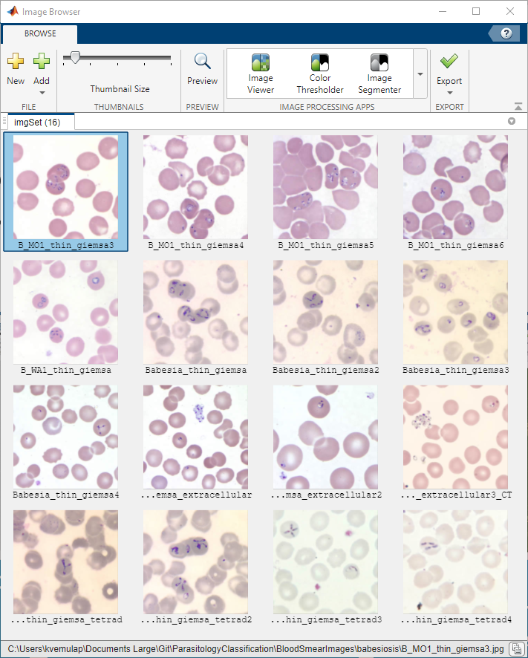
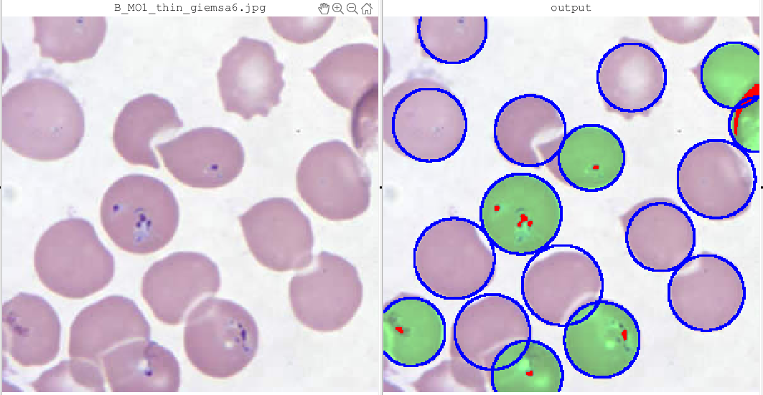
Parasitology example
What percentage of cells in a blood smear have the Babesia parasite?
Input Image vs Image with Babesia Parasite Detections
Babesia Parasite Blood Smear Samples
Notes:
Now we have some of the basics, we get into the next demo, Parasitology demo.
In this demo, we try to find 👆 out how many cells in blood smears are infected with the Babesia parasite. In this demo we 👆 count the number of red bloods cells in an image and the number of them that are infect, and then apply this approach we develop to all other images in the sample dataset.
💻 Run “ParasitologyClassification.prj project” in MATLAB and open “Image Processing And Analysis Demo” in the project shortcuts 👆

Slide 12
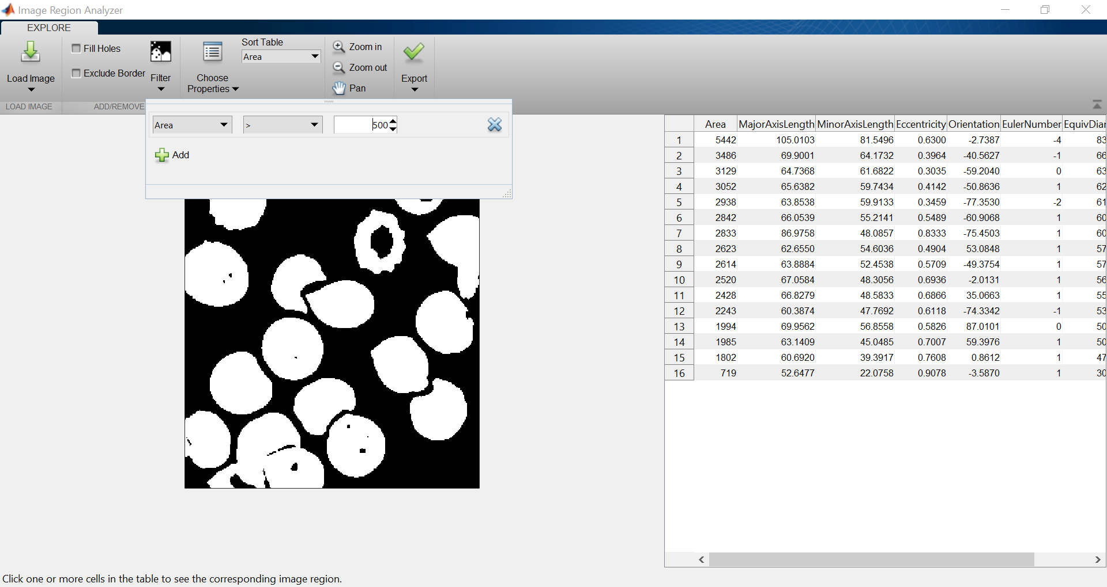
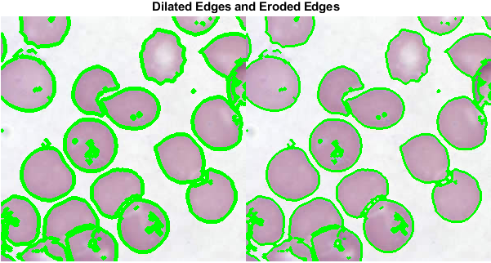
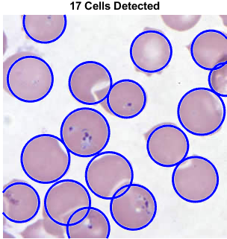
Parasitology Example
Image Region Analyzer App
imdilate and imerode
imfindcircles
Notes:
💻 Return from MATLAB
So, in this demo, we were able to find the infected cells in an images and count them.
A few techniques we used were:
Segmenting the redblood cells and removing regions smaller than a certain size, and filling holes
Finding the edges of cells using edge detection, apply dilation and erosion to enlarge these edges, and then removing the edges to better separate the cells
And using a dedicated circle finding function to find circular objects of interest in the images. 👆

Slide 13
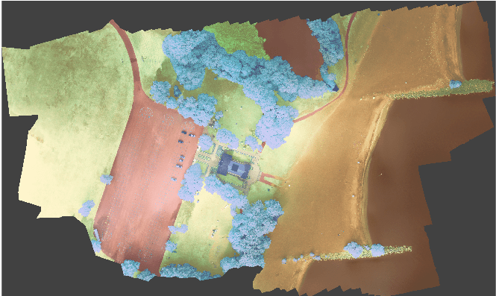
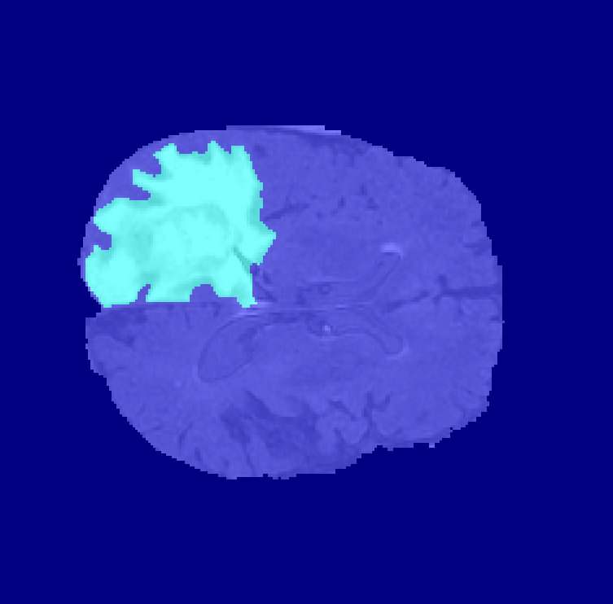
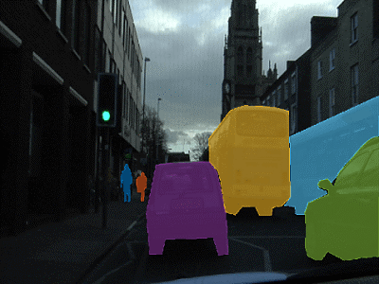
Segmentation
Detecting Tumors in 3D Brain Volumes
Terrain Classification in Multispectral Imagery
Identifying Vehicles and Pedestrian in Videos
Notes:
Until now, we looked at some simple segmentation approaches we can use to solve some problems. But what if we had to solve more complex problems 👆 such as detecting tumors in 3D volumes, classifying terrain in multispectral images, or even identifying vehicle or pedestrians in videos? For these use cases where traditional approaches could be more difficult to use, we can use deep learning where we would create a new segmentation network or use an existing network, and train it for these tasks. 👆

Slide 14
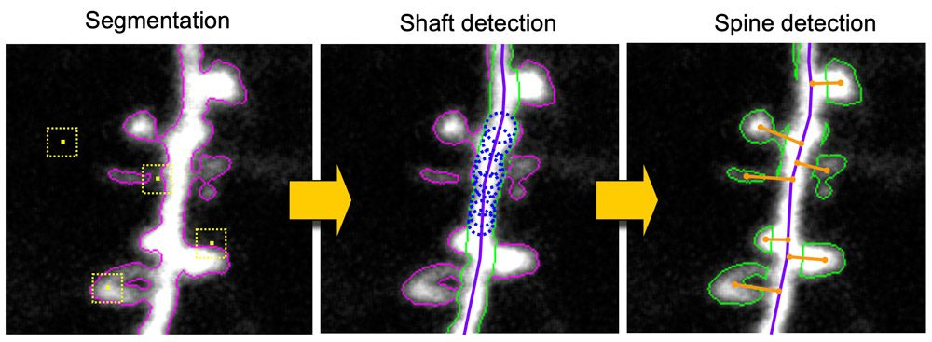
Genentech Evaluates Alzheimer’s Disease Therapeutics
“We trained a convolutional neural network (CNN) on a data set of more than 9,000 images…. The trained CNN has further automated the process of evaluating therapeutics for minimizing spine loss.” - Justin Elstrott, Department of Biomedical Imaging, Genentech Inc.
Notes:
Here we look at how Genentech was able to use out tools to train a deep learning network to segment out the spine and calculate its density to quantify dendritic spine loss. To do this, MathWorks tools helped automate labor intensive images analysis, provided pretrained networks to cut down their training time, reduce the amount of effort needed for classification. 👆
🧠 Additional Notes in next hidden slide

Slide 15
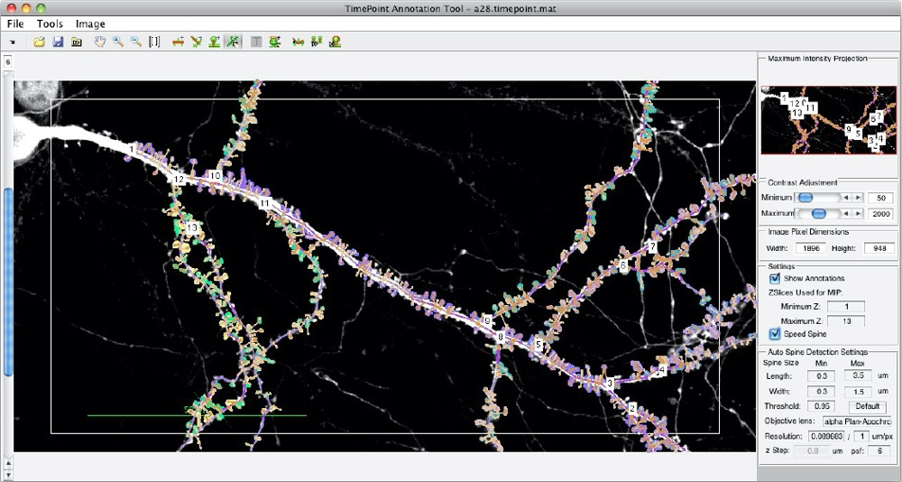
Genentech Evaluates Alzheimer’s Disease Therapeutics with Deep Learning and MATLAB Based Spine Tool
Challenge
Analyze microscopic images to quantify dendritic spine loss, which has been linked to Alzheimer’s disease
Solution
Use MATLAB and Deep Learning Toolbox and work with MathWorks consultants to develop an application that helps automate spine identification and spine density calculations
Results
Labor-intensive image analysis automated
Training time reduced with predefined networks and parallel processing
Classification effort reduced by up to 50%
MATLAB app for automating the detection, annotation, and analysis of dendritic spines.
“We trained a convolutional neural network (CNN) on a data set of more than 9,000 images…. The trained CNN has further automated the process of evaluating therapeutics for minimizing spine loss.” - Justin Elstrott, Department of Biomedical Imaging, Genentech Inc.
Link to article
Notes:
Industries: Biotech and Pharmaceutical, Medical Devices, Neuroscience
Application Areas: Image Processing and Computer Vision, Technical Computing
Capabilities: Algorithm Development, Data Analysis, Machine Learning
Products Used: MATLAB, Computer Vision Toolbox, Deep Learning Toolbox, Image Processing Toolbox, Parallel Computing Toolbox
Country: United States
Published in 2021
Figures/images available in online version
Product names are current at time of technical article publication.
Evaluating Alzheimer’s Disease Therapeutic Targets with Deep Learning and the MATLAB Based Spine Tool
By Justin Elstrott, PhD, Department of Biomedical Imaging, Genentech Inc.
Alzheimer's disease (AD), the most common cause of dementia, is characterized by changes in the brain resulting from the buildup of amyloid plaques. Studies have shown that these hard, insoluble accumulations of beta amyloid proteins are closely linked with the loss of dendritic spines, micron-sized protrusions from a neuron’s dendrite that receive input from other neurons. These studies have led my Genentech colleagues and other AD researchers to preclinically evaluate compounds that reduce spine loss in the presences of amyloid plaques.
To quantify spine loss, we examine microscopic images of mouse brain tissue, counting individual spines along the dendrite and calculating spine density (for example, the number of spines per 100 micrometers of dendrite). When performed manually, this process is extremely labor intensive.
About 10 years ago, our group developed Spine Tool, a MATLAB® image processing application that helps automate spine identification and spine density calculations (Figure 1). While the original version of Spine Tool worked well for in vitro samples, it produced a nontrivial number of false positives and false negatives in ex vivo brain samples, where image quality is lower.
To improve the accuracy of Spine Tool, we worked with MathWorks consultants to incorporate deep learning into the tool. We trained a convolutional neural network (CNN) on a data set of more than 9,000 images that we had annotated with the original Spine Tool. The trained CNN has further automated the process of evaluating therapeutics for minimizing spine loss.
Spine Density Basics
To conduct our studies, we use normal mice (wild-type or WT mice) and mice that express amyloid beta (PS2APP mice), which tend to develop amyloid plaques. Using digital images of microscopic slices of mice brain tissue, we identify and count spines along individual dendrites in both the presence and the absence of visible plaques.
As Figure 2 shows, the presence of the plaque in PS2APP mice corresponds with a visible reduction in the number of nearby spines. That particular study included a third group of mice in which the complement 3 gene (C3KO) was removed; those mice demonstrated significantly less spine loss [1].
We aggregate the spine densities from hundreds of samples to produce a bar chart that compares the densities for different mouse genotypes (Figure 3), revealing that both the reduction in spine density near plaques and the recovery of spine density in C3KO mice are statistically significant. These study results suggest that reducing complement activity could be an effective therapeutic strategy.
Combining Traditional Image Processing with Deep Learning
Earlier versions of Spine Tool identified dendritic spines by applying threshold detection, segmentation, and morphological image processing techniques, as well as custom operations for detecting neuroscience-specific morphologies (Figure 4).
To incorporate deep learning into Spine Tool, we evaluated several predefined network architectures, including Deeplab, SegNet, and U-Net, a network developed for biomedical image segmentation. We chose U-Net for its multiresolution performance.
To reduce training time, we decided to use the 2D version of U-Net rather than the more complex 3D version. Although the data we work with is three-dimensional, it is not isometric: the volumes are only a few slices deep, and a dendritic spine rarely spans more than one or two slices along the Z axis. We created 2D data sets by performing maximum intensity projection of the thin 3D slices. We saved additional time by performing the training on a workstation with NVIDIA® GeForce RTX 2080 Ti GPUs using Parallel Computing Toolbox™.
Initial classification results from the trained network were promising but still included false negatives, identifying fewer spines than we could see ourselves. This was due to a class imbalance problem: the spines are tiny in comparison to the dendrites and the background. We adjusted the class weights across the network and evaluated various loss functions to improve prediction accuracy. We opted to set the weights to maximize sensitivity.
The updated network detected virtually all the spines in an image, but with more false positives. We eliminated these false positive by post-processing the results. For example, we applied length and volume thresholds on the detected spines to weed out any that were too large or too small to be actual spines. To date, our deep learning model shows more promise for time savings than for increased accuracy. The post-processed model predicts ratios of spine density across genotype conditions similar to counts from our ground-truth Spine Tool dataset using traditional image processing (Figure 5), with an up to 50% reduction in manual correction time.
Improving and Validating Spine Tool
Currently we are optimizing the post-processing steps to ensure that neighboring spines detected by the network are properly segmented and counted. Ultimately, we may be able to detect spines more accurately with deep learning than we can via manual inspection, but that capability is not our primary measure of success. Our goal is to verify that, if a treatment effect can be detected by a human, then it can also be detected by the network.
In the coming months, we will use the new deep learning capabilities of Spine Tool to process images for actual studies. In parallel, we will process the images using our existing workflow and compare the results. If, as we expect, the bar charts produced via the two approaches show comparable average spine density, then we will have confirmed that future studies of spine density can be run reliably with the new tool—and with potentially 50% less manual effort.
References
Wu, T. et al. “Complement C3 Is Activated in Human AD Brain and Is Required for Neurodegeneration in Mouse Models of Amyloidosis and Tauopathy.” Cell Reports 28, 2111-2123.e6 (2019).
See more articles and subscribe at mathworks.com/company/newsletters

Slide 16
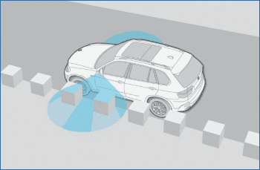
Developing a Motion-Stereo Parking Assistant at BMW
Challenge
Deliver a cost-effective driver-assistance system for parking in tight spaces
Solution
Develop a motion-stereo system that constructs a 3-D model of the area around the car from 2-D images generated by a single side-view camera
Results
Image processing algorithms developed 3–4
times faster than in C or C++
Innovative features added without increasing manufacturing costs
Algorithm debugging time reduced
Vehicle equipped with side-view camera. As the vehicle moves, the side-view camera acquires images that are used to measure depth.
“Developing image processing applications typically requires many matrix calculations and filtering steps. We have found that coding these applications in C or C++ takes three to four times longer than coding them in MATLAB.” - Dr. Eric Wahl, BMW Group; Dr. Rolf-Dieter Therburg, THECON
Link to article
Notes:
Primary Industry: Automotive
Secondary Industries: n/a
Product Capabilities: Data Analysis, Algorithm Development, Desktop and Web Deployment
Applications: Image and Video Processing
Products Used: MATLAB, MATLAB Compiler, Image Processing Toolbox
Country: Germany
Product names are current at time of technical article publication.
Published in MATLAB Digest November 2008
Developing a Motion-Stero Parking Assistant at BMW
By Dr. Eric Wahl, BMW Group and Dr. Rolf-Dieter Therburg, THECON
For many drivers, finding and then navigating a vehicle into a suitable parking spot is a challenge—mainly because the driver cannot see around the vehicle or determine the size and shape of the parking space.
Several automotive manufacturers, including BMW, now equip vehicles with side-view cameras, which drivers can use to examine blind areas around the car. These cameras provide only a visual representation (a two-dimensional video image) of the area, and are not well-suited to evaluating the size of a potential parking spot or warning the driver of hazards in the car’s path. These more complex tasks require a spatial representation. Some companies are working on ultrasonic- and LIDAR-based driver-assistance systems, but such systems impose the cost of additional sensors, and typically have relatively low range and resolution, not to mention low classification abilities.
At BMW, we have developed a motion-stereo system that constructs a 3-D model of the area around the car from 2-D images generated by a single side-view camera (Figure 1). Because it uses the generic 2-D camera already installed on BMW vehicles, the motion-stereo approach offers a cost-effective alternative to solutions that require specialized sensors.
Using MATLAB®, Image Processing Toolbox™, and THECON’s MATLAB based MOBIL Image Acquisition and Processing Toolbox, engineers from BMW and THECON developed a real-time prototype of the system, which combines images taken from different car positions with vehicle speed, wheel position, and angles data to determine the shape and dimensions of the parking space. In addition to parking assistance, the 3-D representation produced by the system can be used for a variety of other applications, including collision avoidance and automated warnings of curbs and obstacles.
What is Motion Stereo?
To create 3-D images of the environment, robotics researchers often use multiple cameras that capture at least two images of the same scene taken at the same instant but from different positions or angles. This procedure is called stereo. Motion stereo varies this concept by exchanging a multiple camera with a single camera that is moved to determine different positions.The motion-stereo system developed at BMW uses the same approach, using two images taken by a single camera and relying on the motion of the automobile to change the point of view from image to image.
While the relative position of the twin cameras in a stereo camera is fixed and well-known, in a motion-stereo system the relative positions change with the speed and direction of the automobile. As a result, our system must gather velocity and wheel position and angles data from the car’s CAN bus and then apply sophisticated object-reconstruction algorithms to transform the 2-D point clouds from sequential images into a 3-D model.
Processing a Series of Images
The first iteration of the system used images collected from the side-view camera while the car was moving past parking spaces. In this phase, the orientation and position of the camera were predetermined; development focused on filtering the images and constructing a 3-D representation. We used MATLAB eigenvalue and Hessian matrix operations to create stable edge-detection algorithms (Figure 2).
Image Processing Toolbox functions and the visualization capabilities of MATLAB were particularly helpful as we debugged the edge-detection algorithms. For example, after filtering an image or performing a matrix operation, we could visually compare the original with the new image to validate the results. This kind of debugging is very time-consuming in C or other low-level languages because it requires custom visualization code for each step. Developing image processing applications typically requires many matrix calculations and filtering steps. We have found that coding these applications in C or C++ takes three to four times longer than coding them in MATLAB.
After developing the object reconstruction algorithms in non-real-time, we verified that we could perform the necessary processing as the images were acquired at the camera’s standard rate of 50 frames per second. To acquire and process images, we used the MOBIL toolbox. The toolbox combines MATLAB with the real-time image acquisition of a frame-grabber. Operation is carried out with a GUI into which camera images are displayed as stills or as live video. A MEX DLL places function calls for initializing the frame-grabber, changing camera parameters, acquiring and displaying live images, and transferring images into MATLAB arrays.
With the MOBIL toolbox, real-time image acquisition operates autonomously in the background of the application program with a separate task in kernel mode. Acquired images are stored in a ring buffer structure and signaled to the MATLAB application for further processing. Basic filtering functions in the MOBIL toolbox operate directly in the acquisition buffer. These preprocessed arrays are transferred to MATLAB and are then handled with Image Processing Toolbox.
Integrating CAN Bus Data
To construct a 3-D model from two consecutive camera images, we need to determine how the position and orientation of the camera have changed from image to image. We calculate these changes using data on the vehicle’s speed and direction, acquired via the CAN bus. Our CAN bus interface module, developed in MATLAB, acquires vehicle speed and wheel angle data every 100 milliseconds. The CAN bus interface communicates autonomously with the car to send live signals and receive and decode messages for navigation purposes.
In practice, a car may be traveling at speeds of up to 30 kilometers per hour as the driver looks for a parking space. At these speeds, we must process every image from the camera because we need all the information available. Camera data, however, arrives at a faster rate than CAN bus data, and the two data sources are not synchronized. To determine camera position for each image, we used a Kalman filter in MATLAB to denoise the CAN bus data and then calculated the vehicle’s route by interpolating the available data points into a smooth curve
Test-Driving the Prototype
To test the system in real-world conditions, we assembled a prototype system and conducted test drives in a BMW 5 Series Touring. We used MATLAB Compiler™ to build a standalone executable of the motion-stereo application, which we deployed to a ruggedized mobile PC with 12 VDC power supply equipped with a 2.4 GHz Intel Core2Duo 4 processor, 2 GB RAM, an asynchronous 4-channel image acquisition board, and a CAN bus hardware interface.
A screenshot of the application is shown in Figure 3.
Initial road tests revealed a weakness in the original algorithms. Periodic background structures such as fences and cobblestones caused the system to misinterpret depth values. We corrected the problem by using MATLAB to create a filter for these kinds of objects.
The system performed well during test drives, easily keeping up with the supply of real-time images and CAN data. When the system is used in production, the application will run on an embedded processor and use the vehicle’s on-board LCD display screen.
Identifying Objects
In developing the prototype, we were careful to separate the object construction and object identification functions. This distinction enables engineers throughout BMW, as well as third-party vendors, to design applications that use the 3-D data for different purposes in different vehicles. Control engineers, for example, can use the data to automatically park a vehicle. Since many BMW control engineers also use MATLAB, there is an opportunity to simulate a complete system that combines their control models with our MATLAB application.
Work is currently under way to improve object construction by increasing the density of point clouds. We are also working on improved object identification, which will enable the system to classify street light poles, curbs, and other objects—a task that is all but impossible with ultrasonic systems. In further experiments we will be evaluating the use of a top-view camera, which provides a wider-viewing angle but lower resolution than the side-view camera.
Using the movement of the car to assemble 3-D data from a single camera is an example of BMW innovation in the automotive industry. Costly sensors are useful for research but impractical for real applications. By using equipment already on our vehicles, we can provide timely alerts and information to our customers, adding value without increasing manufacturing costs.

Slide 17
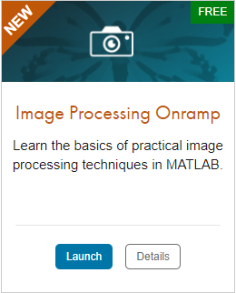
TO DO
Go to https://matlabacademy.mathworks.com/
Log in to your MathWorks account
Launch Image processing Onramp

Slide 18
Additional Learning Resources:
Follow @matlab_students on Instagram for tips/tricks, videos, and more!
This account is managed by MathWorks and is specifically for students!
Star the Awesome MATLAB Student Repository on GitHub and Bookmark the MATLAB & Simulink Resources for Students page.
Check out some of the other Student Program opportunities at MathWorks.

